Slide 1
Reflex arc

Slide 2
Learning outcomes
Describe the stages of the reflex arc

Slide 3
Reflexes Introduction
Reflexes are automatic, unconscious to changes, either inside or outside the body.
They do not immediately involve the brain
Reflexes allow quicker reaction times to potentially harmful stimulus
Many of the actions we carry out every day done without conscious thought
These are called Reflex Actions
They are impulses in reflex actions do not follow the same path as those in conscious actions
Notes:
Homeostasis is the state of steady internal conditions maintained by living things. This dynamic state of equilibrium is the condition of optimal functioning for the organism and includes many variables, such as body temperature and fluid balance, being kept within certain pre-set limits (homeostatic range).

Slide 4
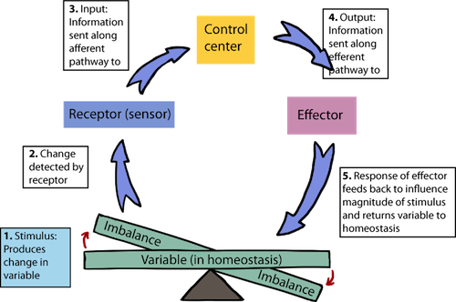
Reflexes
Reflexes maintain autonomic systems – heart rate, breathing rate, blood pressure, digestion.
Reflexes maintain balance and posture; e.g., spinal reflexes control trunk and limb muscles.
Brain reflexes involve reflex center in brainstem; e.g., reflexes for eye movement.

Slide 5
More examples of Reflex Arcs
Knee jerk reaction – involved in keeping standing
Pupil Dilation – Protect eyes from light
Vomit Reflex
Cough Reflex
Sneeze Reflex
Eye tracking Reflex
Nausea

Slide 6
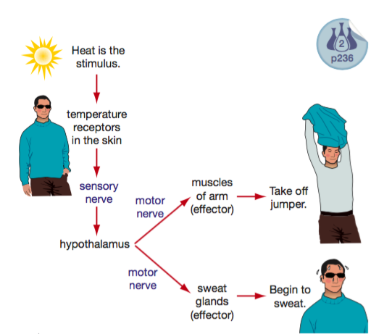
Responding to stimuli
A simple model of your nervous system is a stimulus – response model.
Receptors stimulate the sensory nerves.
The sensory nerves send a message to the brain.
Notes:
The brain works out the response that is required, then sends a message along motor nerves to the effectors—the muscles or glands that will put the response into effect.
This stimulus–response diagram represents your body’s reaction to being too hot.

Slide 7
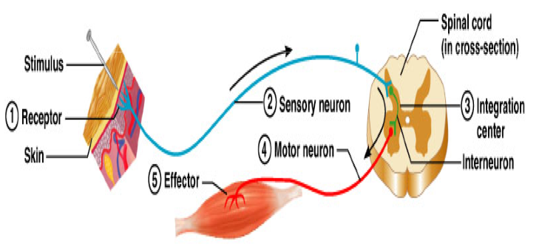
Reflex Arc
The reflex arc governs the operation of reflexes.
Nerve impulses follow nerve pathways as they travel through the nervous system.
Notes:
Within the spinal cord, a relay neurone passes the message directly to a motor neurone, which sends impulses to the arm muscles, which are the effectors. The arm muscles contract, lifting your hand away from the hot object. A message is sent to the brain shortly afterwards. Only then can the brain register pain. The nerve pathway operating in a reflex action is called a reflex arc. Figure 7.1.16 shows an example of a reflex arc. Most reflex actions involve only a few neurones and are therefore very rapid.

Slide 8
Reflex Arc
The simplest of these pathways, which include only a few neurons, is called the reflex arc.
Reflexes whose arc passes through the spinal cord are called spinal reflexes.
Notes:
Within the spinal cord, a relay neurone passes the message directly to a motor neurone, which sends impulses to the arm muscles, which are the effectors. The arm muscles contract, lifting your hand away from the hot object. A message is sent to the brain shortly afterwards. Only then can the brain register pain. The nerve pathway operating in a reflex action is called a reflex arc. Figure 7.1.16 shows an example of a reflex arc. Most reflex actions involve only a few neurones and are therefore very rapid.

Slide 9
Reflex arc

Slide 10
Parts of the Reflex Arc
Receptor – detects the stimulus.
Sensory neuron – conveys the sensory information to brain or spinal cord.

Slide 11
Parts of the Reflex Arc
3. Interneuron: relay neurons.
4. Motor neuron: conduct motor output to the periphery.

Slide 12
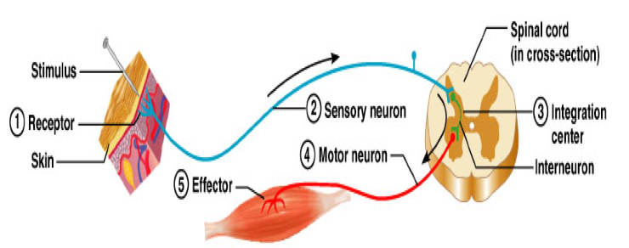
Parts of the Reflex Arc
5. Effector: a muscle or gland that responds to stimulation to produce reflex or behavioural actions

Slide 13


Flow chart

Slide 14
Reflex action
During a reflex action, the sensory neuron carries the message from the receptor to the spinal cord.
The interneuron then sends two messages at the same time, one to the brain and the other to the muscles via the motor neuron.
This means the muscle is moving at the same time as the brain gets the message that the object was hot.
This make reflexes even faster than usual responses.

